Slide 1
SICOB NEXT JOURNAL CLUB:
MAGNETIC SURGERY
Amanda belluzzi,MD
U.O.C. chirurgia generale, Ospedale S. Maria della Misericordia, Rovigo

Slide 2
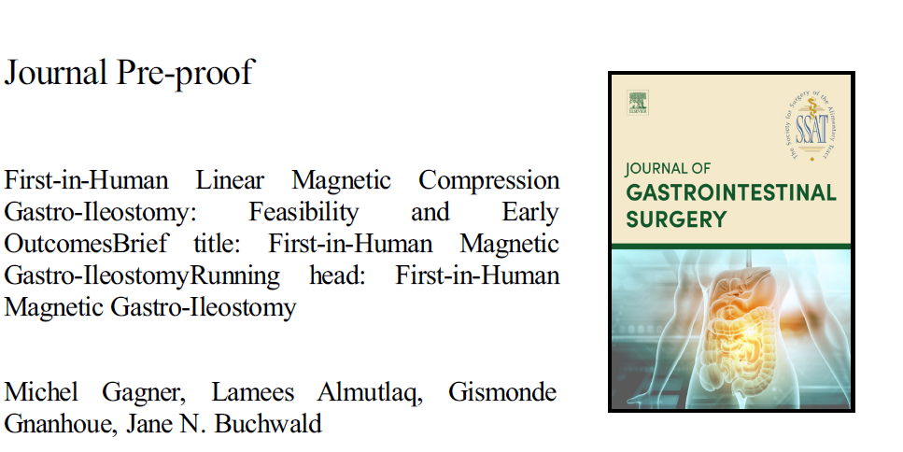
2025
Gagner M, Almutlaq L, Gnanhoue G, Buchwald JN. First-in-Human Linear Magnetic Compression Gastro-Ileostomy: Feasibility and Early Outcomes. J Gastrointest Surg. 2025 Apr 29:102067. doi: 10.1016/j.gassur.2025.102067. Epub ahead of print. PMID: 40311795.
First-in-human study, patients with obesity underwent magnetic gastro-ileostomy bipartition for weight loss. The procedure was feasible, safe, and required no stapling/suturing or retained foreign materials. 100% of patients formed patent anastomoses resulting in clinically meaningful total and excess weight loss (18.9%; 52.4%) with 0.0% major complications

Slide 3
2025
Gagner M, Almutlaq L, Gnanhoue G, Buchwald JN. First-in-Human Linear Magnetic Compression Gastro-Ileostomy: Feasibility and Early Outcomes. J Gastrointest Surg. 2025 Apr 29:102067.

Slide 4
2025
the magnetic gastro-ileal (MagGI) biofragmentable system
the MagGI magnet separated into three parts (one central magnet and two distal titanium
pieces) following biofragmentation of the flange.
The distal MagGI magnet is placed orogastrically by flexible gastroscope post pyloric and transported by laparoscopic magnetic positioning device to the target ileal position 250 cm proximal to the cecum.
The second, proximal, MagGI magnet is delivered by gastroscope to the distal antrum of the post-SG stomach.
The distal magnet is elevated by the positioning device over the transverse colon and brought into apposition with the proximal magnet in the stomach, aligning magnetically with the distal magnet, and the mesenteric defect is closed.
The magnets gradually compress and fuse, forming the GI anastomotic bipartition; the flange of the magnet pair fragments anddetaches from the GI site and passes naturally by peristalsis.
Alimentary content flows through both the pylorus and the patent GI bipartition to the ileal lumen .
Gagner M, Almutlaq L, Gnanhoue G, Buchwald JN. First-in-Human Linear Magnetic Compression Gastro-Ileostomy: Feasibility and Early Outcomes. J Gastrointest Surg. 2025 Apr 29:102067.

Slide 5
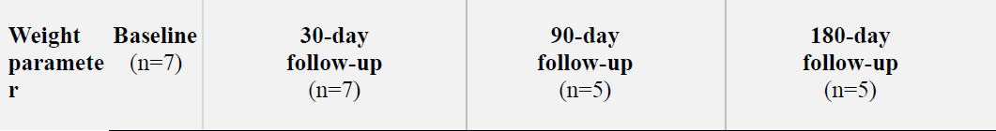
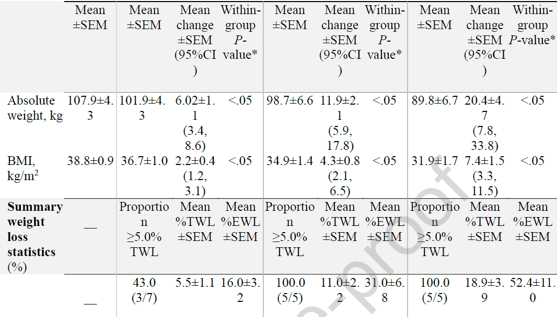
2025
This first-in-human MagGI System study found that magnets were feasibly placed to effect magnetic gastro-ileostomy revision of SG. From operative day 1 through 180-day follow-up, no bleeding, leakage, infection, stricture, or obstruction occurred. The mean MagGI EWL of 52.4%, TWL of 18.9%, and primary SG + revisional MagGI CTWL of 38.8±4.4% demonstrated promising efficacy over the short term.
Gagner M, Almutlaq L, Gnanhoue G, Buchwald JN. First-in-Human Linear Magnetic Compression Gastro-Ileostomy: Feasibility and Early Outcomes. J Gastrointest Surg. 2025 Apr 29:102067.

Slide 6
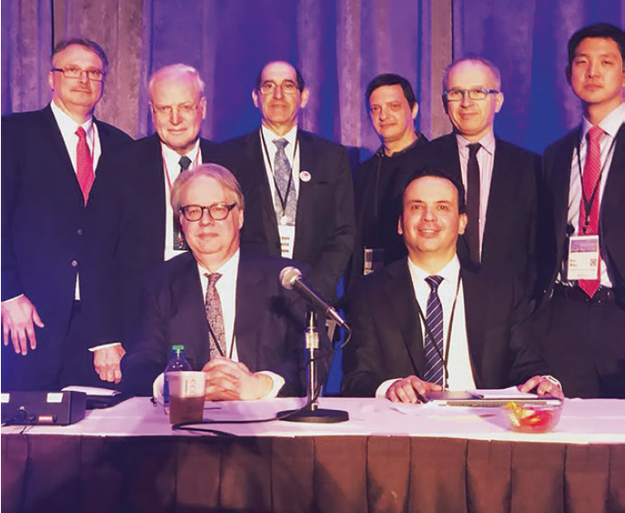
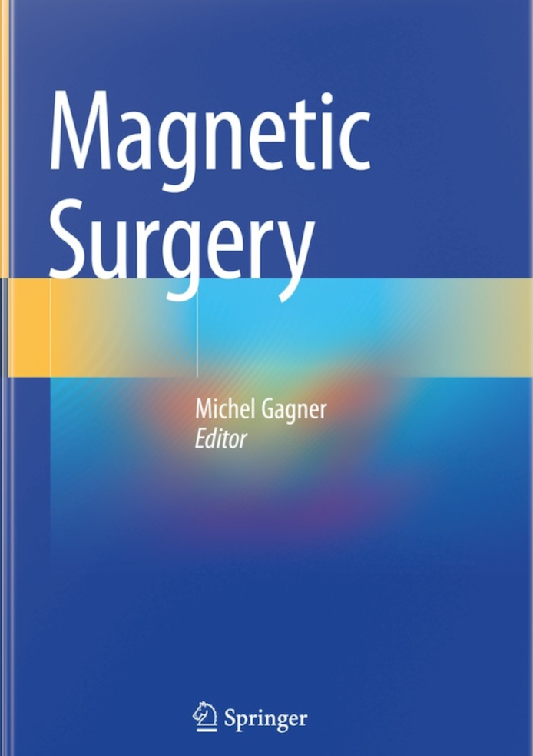

2021
Seattle, 2018, 16th World Congress of Endoscopic Surgery
Magnet Surgery: What’s the Attraction?
Gagner M, Magnetic Surgery. Springerhttps://doi.org/10.1007/978-3-030-73947-8

Slide 7
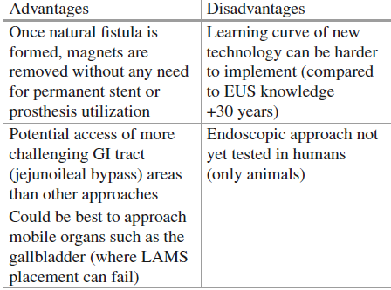
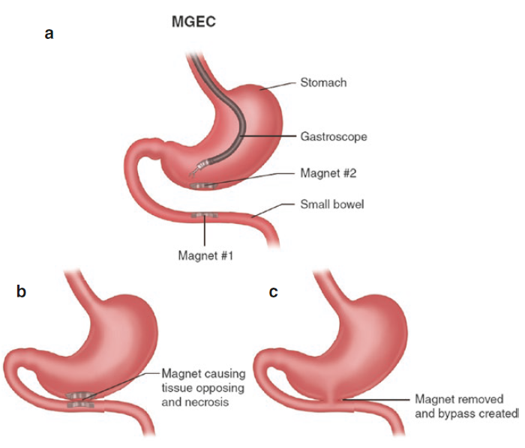
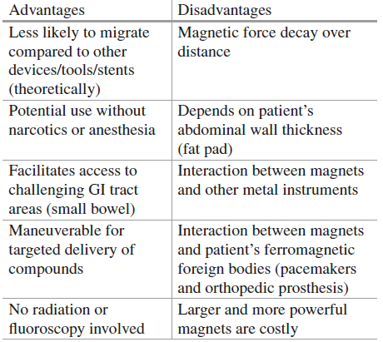
MGEC remarks
2021
Magnets for gastroenterostomy creation (MGEC).
Magnets in endoscopy remarks
Gagner M, Magnetic Surgery. Springer. https://doi.org/10.1007/978-3-030-73947-8

Slide 8
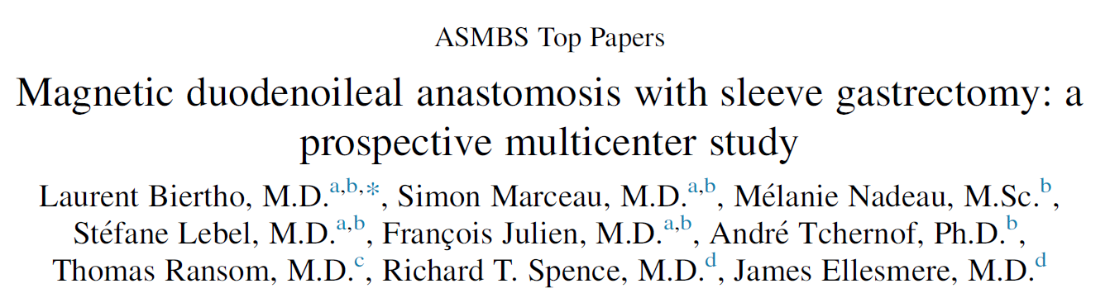
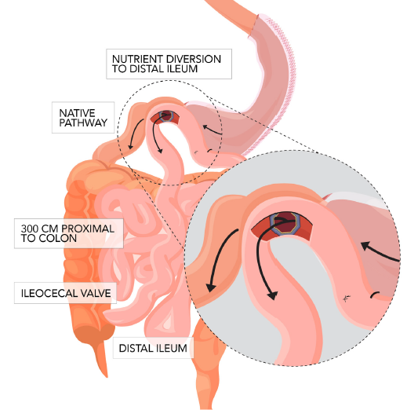
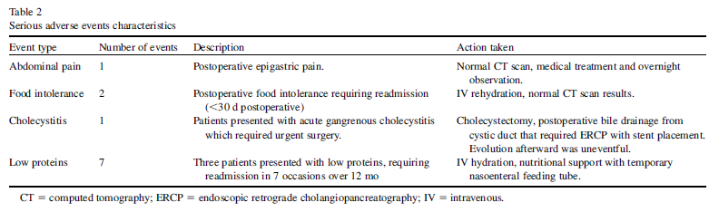
2025
Prospective, nonrandomized multicenter trial. Participants with T2DM who met criteria for metabolic surgery were recruited.
A dual-path duodenoileal anastomosis created at 300 cm from the ileocecal valve using circular magnetic anastomosis. The proximal magnet was deployed by endoscopy and the distal one by laparoscopy. Sleeve gastrectomy was performed at the same time. Mean time for anastomosis creation was 32 ± 10 minutes.
19 patients enrolled, baseline BMI 43±5 kg/m², TWL% at 3, 6, and 12 months was 22±19%, 28±19%, and 31±11%, respectively. EWL% was 45±14%, 59±21%, and 78±33%, respectively. All patients had a Hemoglobin A1C ≤ 6.0% at 12 months with complete T2DM remission in 78%.
A total of 41 procedure-related adverse events were recorded during follow-up. Seven events in 4 subjects were considered serious.
Biertho L, Marceau S, Nadeau M, Lebel S, Julien F, Tchernof A, Ransom T, Spence RT, Ellesmere J. Magnetic duodenoileal anastomosis with sleeve gastrectomy: a prospective multicenter study. Surg Obes Relat Dis. 2025 Feb;21(2):166-174.

Slide 9
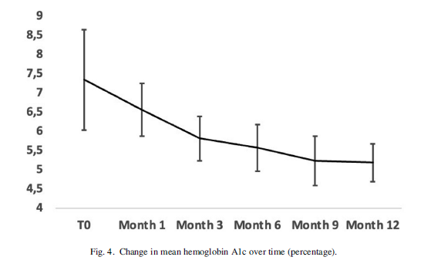
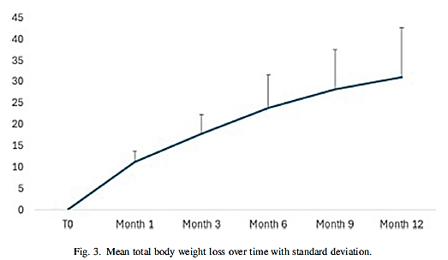
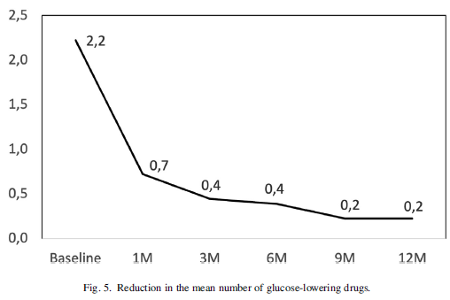
2025
Biertho L, Marceau S, Nadeau M, Lebel S, Julien F, Tchernof A, Ransom T, Spence RT, Ellesmere J. Magnetic duodenoileal anastomosis with sleeve gastrectomy: a prospective multicenter study. Surg Obes Relat Dis. 2025 Feb;21(2):166-174.

Slide 10
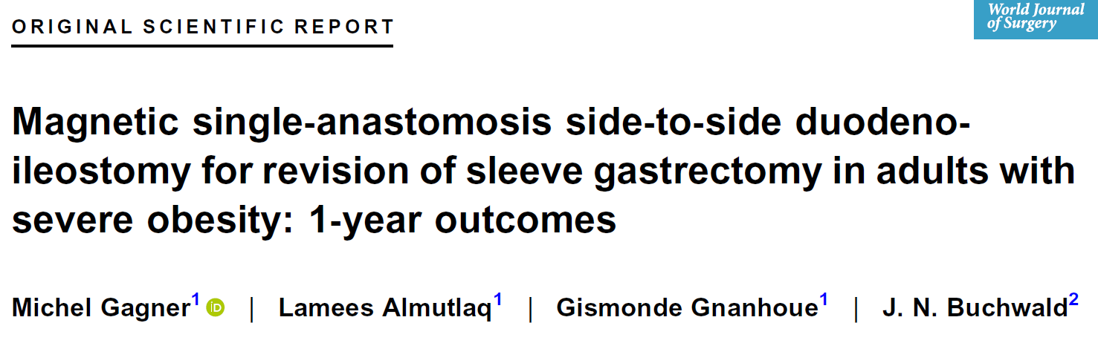
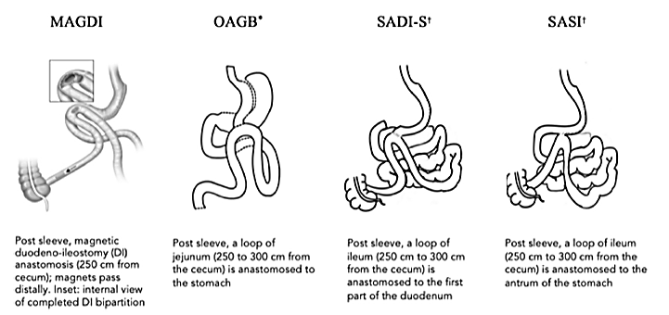
2024
prospective single‐center study assessing feasibility,safety, and efficacy of the novel linear magnetic anastomosis system (LMAS [3 cm]) in performing a side‐to‐side duodeno‐ileostomy (MagDI) bipartition to revise clinically suboptimal primary sleeve gastrectomy (SG).
Patients with severe obesity with/without type 2 diabetes (T2D) with suboptimal weight loss, regain, and/or T2D recurrence post SG underwent revisional MagDI. A distal and proximal magnet were delivered endoscopically to the ileum and duodenum and aligned via laparoscopic assistance. Gradual magnet fusion formed a DI bipartition.
24 patients (mean age 44.9 ± 1.5 years, and BMI 39.4 ± 1.3 kg/m2) underwent MagDI. Feasibility was attained via correct magnet placement (mean operative time 63.5 ± 3.3 min), patent anastomoses created, and magnet passage per anus in 100.0% of patients.
Safety profile and Outcomes: 4 CD‐III mild or moderate severe AEs, 0.0% associated with the LMAS or MagDI: 0.0% anastomotic leakage, obstruction, bleeding, infection, reintervention, or death. Mean BMI reduction was 2.1 kg/m² (p < 0.05); total weight loss 5.3%, excess weight loss 16.4%; and the patient with T2D improved.
Gagner M, Almutlaq L, Gnanhoue G, Buchwald JN. Magnetic single-anastomosis side-to-side duodeno-ileostomy for revision of sleeve gastrectomy in adults with severe obesity: 1-year outcomes. World J Surg. 2024 Oct;48(10):2337-2348.

Slide 11
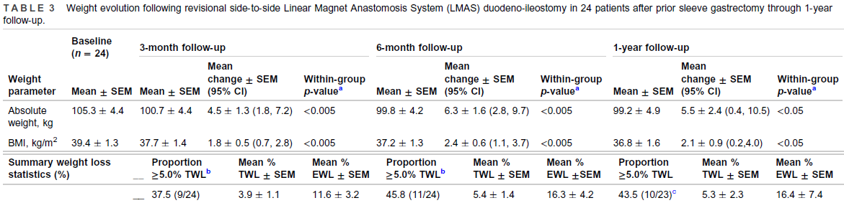
2024
Gagner M, Almutlaq L, Gnanhoue G, Buchwald JN. Magnetic single-anastomosis side-to-side duodeno-ileostomy for revision of sleeve gastrectomy in adults with severe obesity: 1-year outcomes. World J Surg. 2024 Oct;48(10):2337-2348.

Slide 12
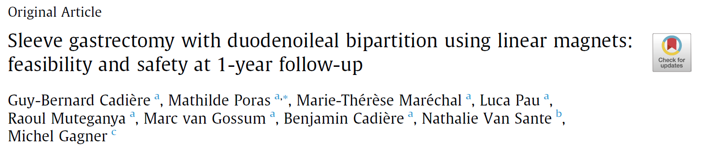
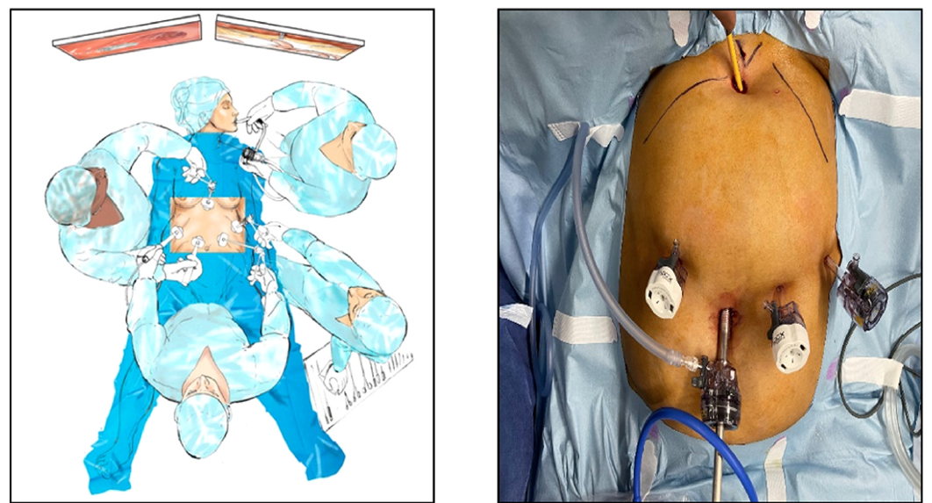
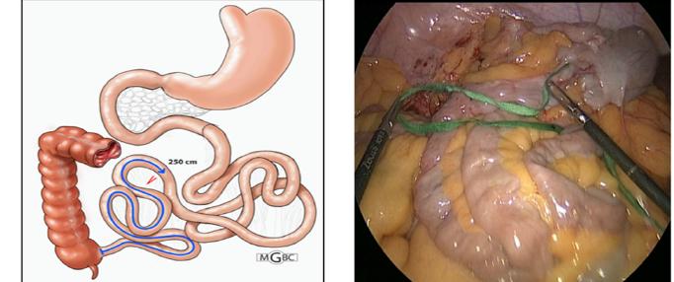
2024
Side-to-side DI bipartition with the magnet anastomosis system (MS) with SG. By endoscopic positioning, a distal magnet (250 cm proximal to the ileocecal valve) and a proximal magnet (first part of the duodenum) were aligned with laparoscopic assistance to inaugurate MCA. An isotopic study assessed transit through the bipartition.
10 patients (BMI of 44.2 ± 1.3 kg/m²) . In 9 of 10 patients, an SG was performed concurrently. The median operative time was 161.0 minutes and the median hospital stay was 3 days .Paired magnets were expelled at a median of 43 days. There was no device-related serious advanced event within 1 year. All anastomoses were patent with satisfactory diameters after magnet expulsion and at 1 year.
Respective BMI, BMI reduction, and total weight loss were 28.9 ± 1.8 kg/m², 15.2 ± 1.8 kg/m², and 34.2% ± 4.1%, respectively. Of note, 70.0% of patients reported that they were very satisfied. The isotopic study found a median of 19.0% of the meal transited through the ileal loop.
Cadière GB, Poras M, Maréchal MT, Pau L, Muteganya R, Gossum MV, Cadière B, Sante NV, Gagner M. Sleeve gastrectomy with duodenoileal bipartition using linear magnets: feasibility and safety at 1-year follow-up. J Gastrointest Surg. 2024 May;28(5):640-650.

Slide 13
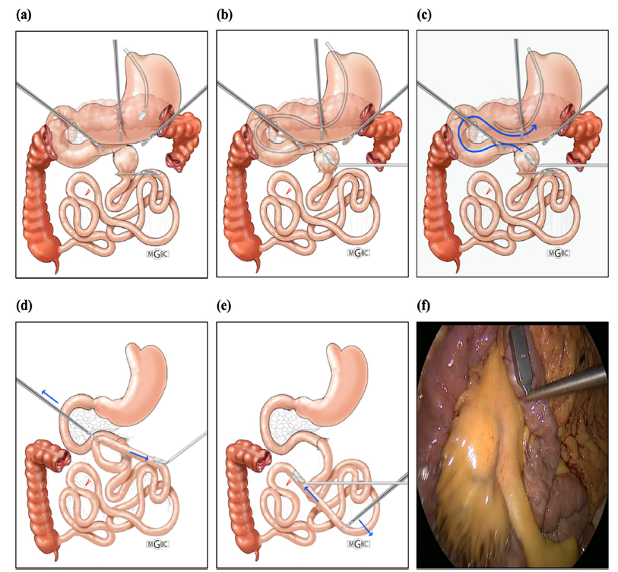
2024
Cadière GB, Poras M, Maréchal MT, Pau L, Muteganya R, Gossum MV, Cadière B, Sante NV, Gagner M. Sleeve gastrectomy with duodenoileal bipartition using linear magnets: feasibility and safety at 1-year follow-up. J Gastrointest Surg. 2024 May;28(5):640-650.

Slide 14
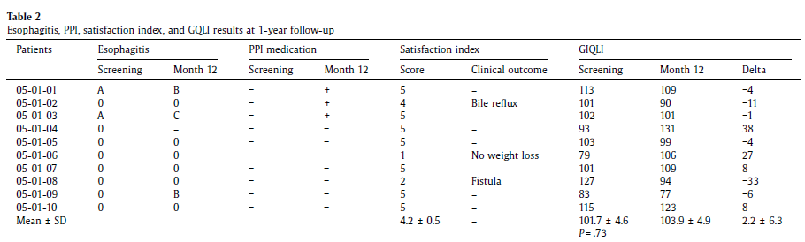
2024

Slide 15
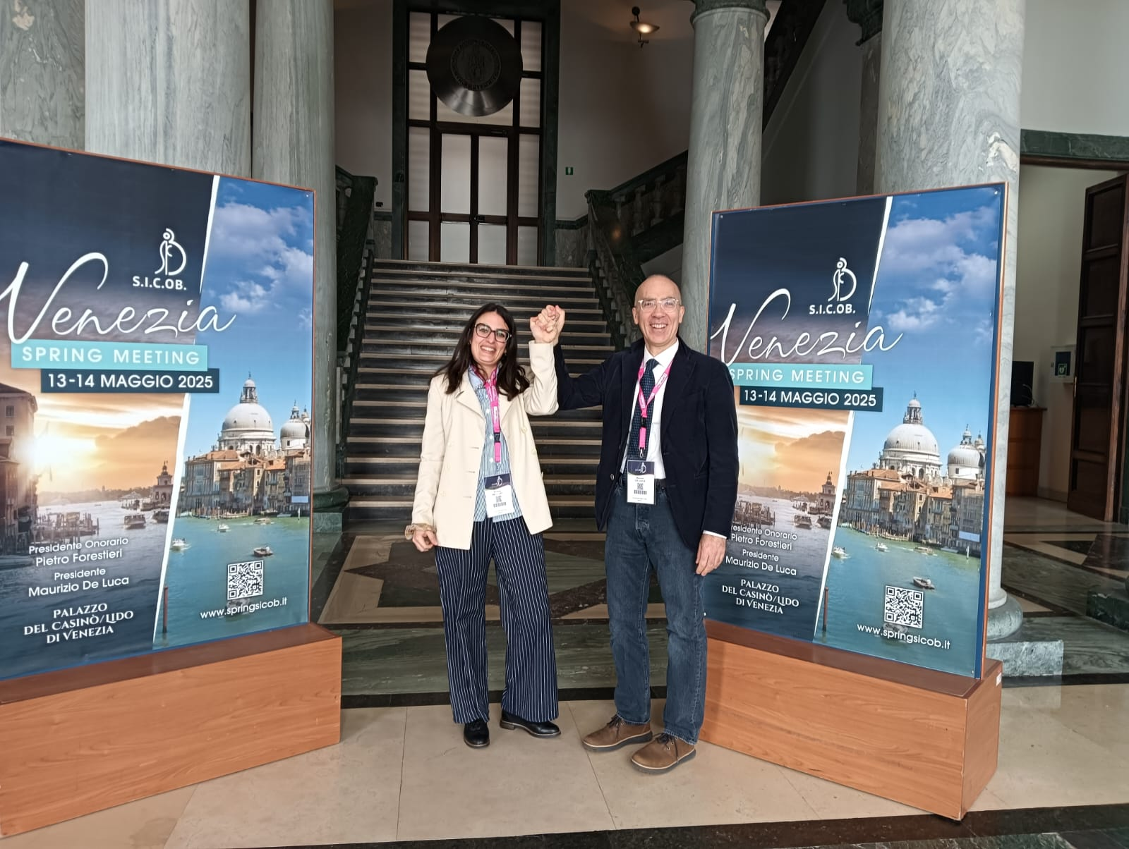
Grazie per l’attenzione

